Slide 1


coffee empire expansion
Abraham Ho, Abhishek Bhatt,
Peter Lai

Slide 2
Target
Starbucks stores located in 50 states
Key Metrics:
Population
Personal Income
Labor Force

Slide 3
Data gathering
Starbucks Location: https://www.kaggle.com/
Personal Income Data: https://www.bea.gov/
Labor Force in each State: https://www.bls.gov/

Slide 4
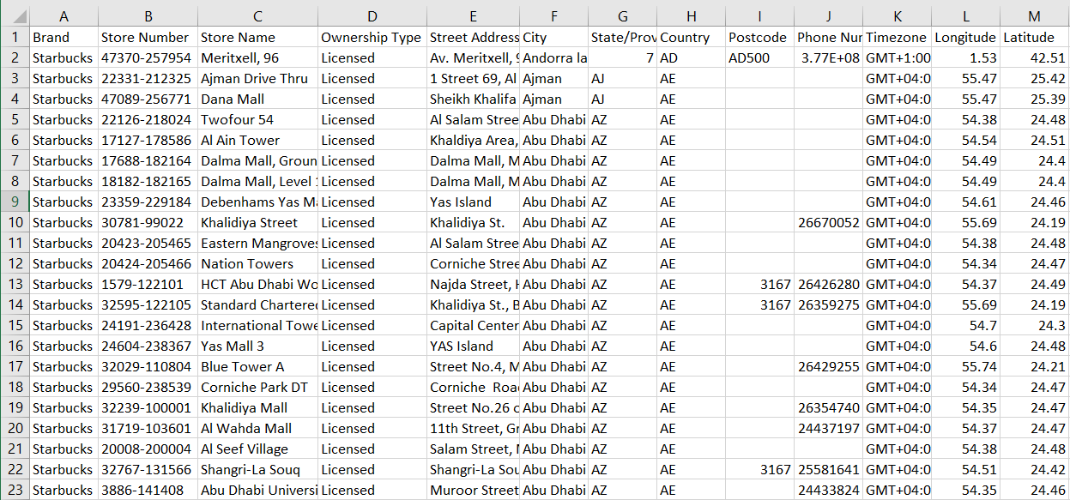
Raw data – starbucks location worldwide
dataset includes a record for every Starbucks or subsidiary store location currently in operation as of February 2017.

Slide 5
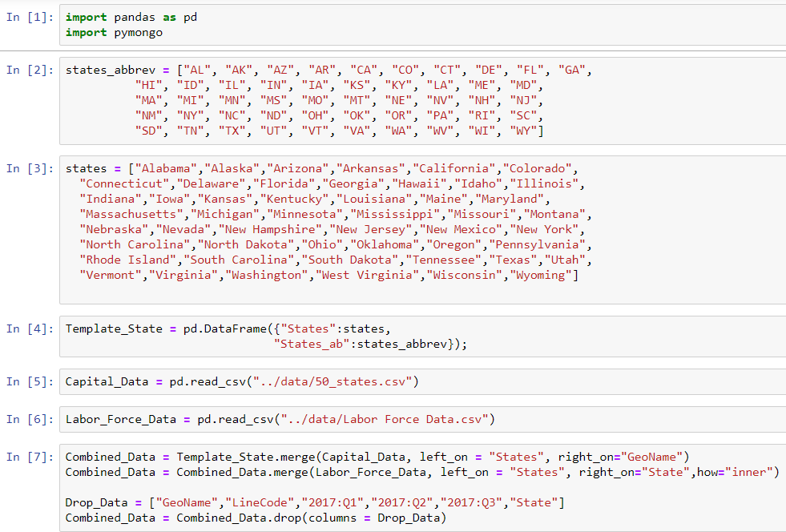
Mongo db database

Slide 6
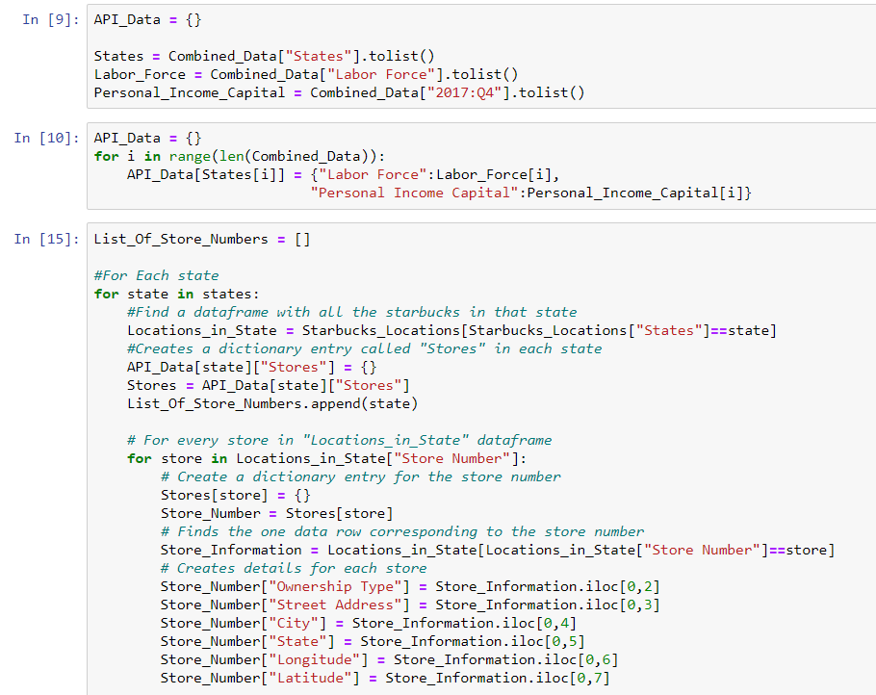
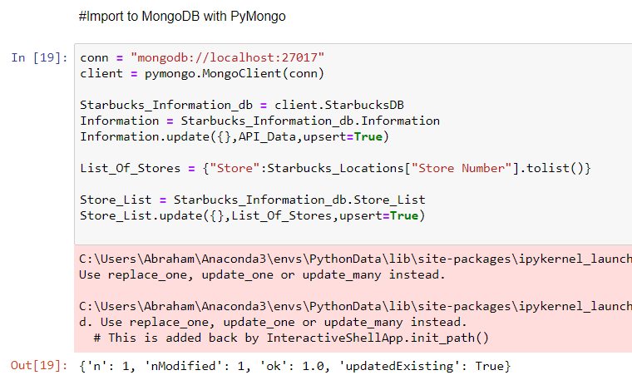

Slide 7
Consumer
Competitor
Market

